Slide 1





RiverScope: High-Resolution River Masking Dataset
Rangel Daroya¹, Taylor Rowley¹, Jonathan Acero Flores¹, Elisa Friedmann¹, Fiona B Bennitt¹, Heejin An¹, Travis Thomas Simmons¹, Marissa Hughes², Camryn L Kluetmeier², Solomon Kica², J. Daniel Vélez², Sarah E. Esenther³, Thomas E. Howard³, Yanqi Ye³, Audrey J. Turcotte⁴, Colin Gleason¹, Subhransu Maji¹
1
2
3
4

Slide 2
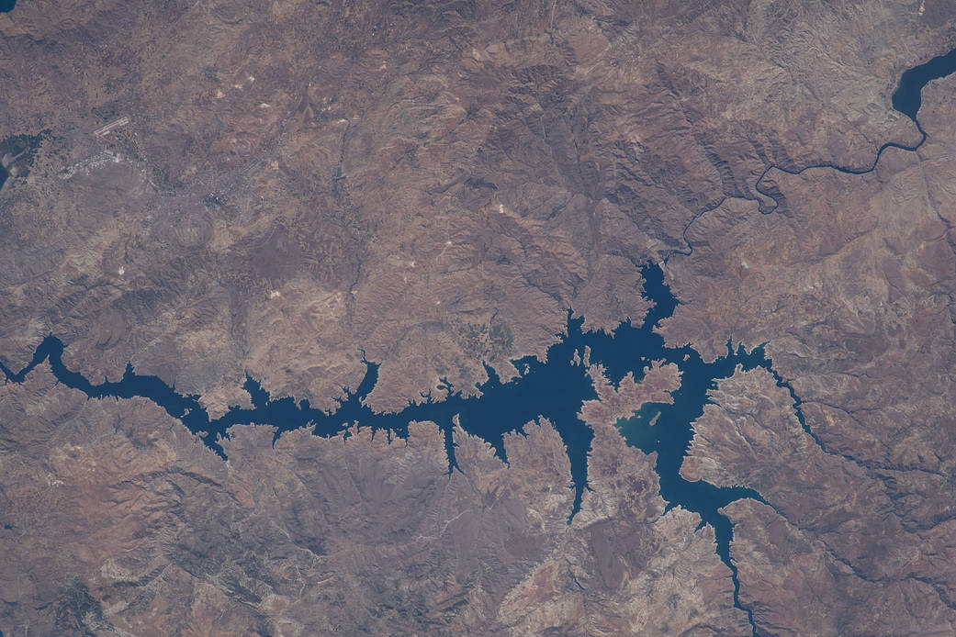
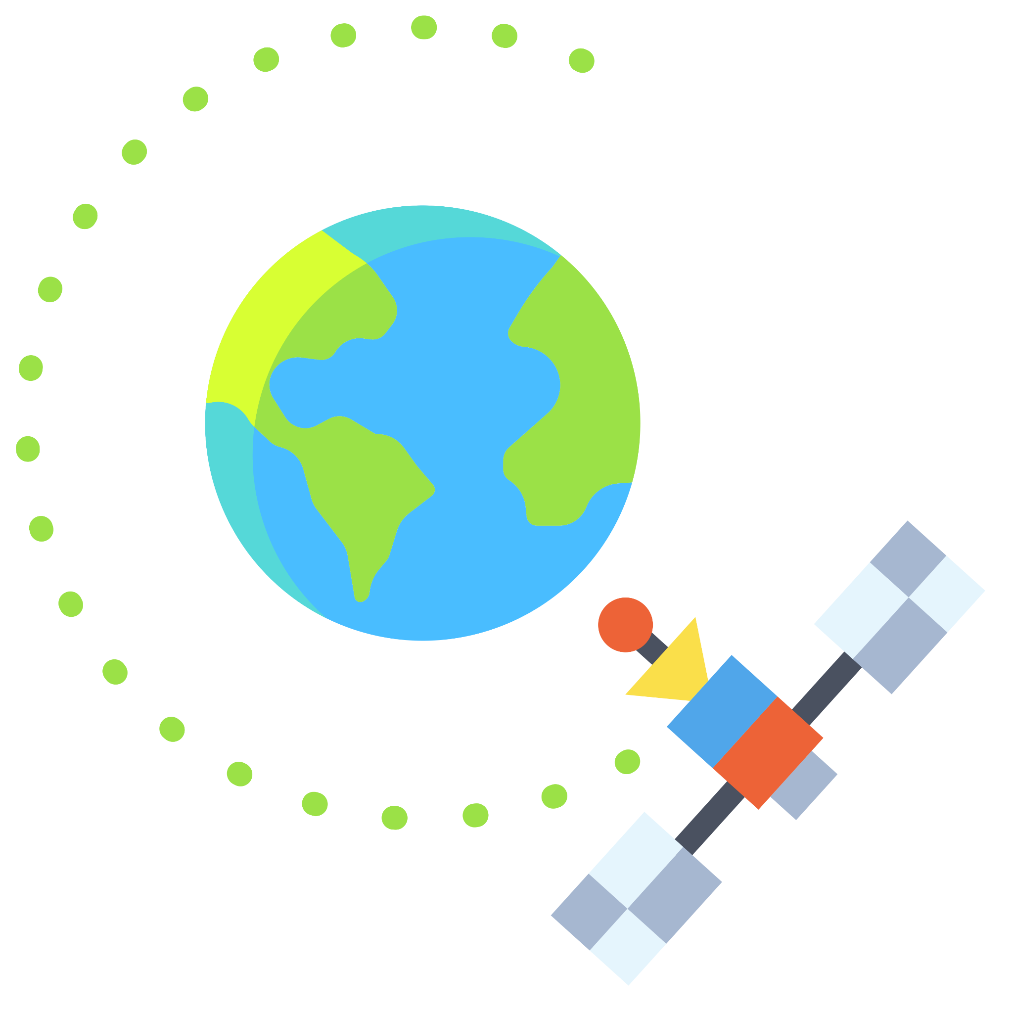
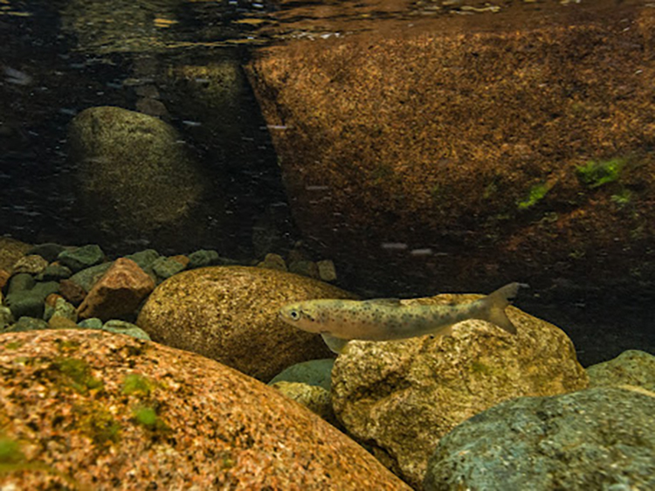
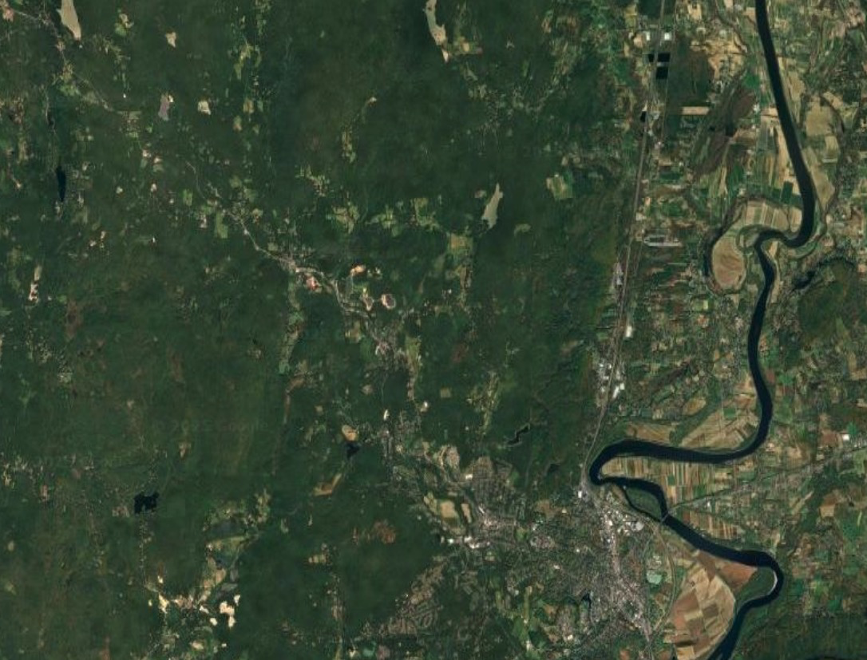
Importance of global river monitoring
Rivers influence ecosystems, agriculture, disaster resilience, and sustainable development
Remote sensing has enabled frequent river monitoring at a global scale
Euphrates River and Keban Dam Reservoir [1]
Atlantic salmon in river habitat [2]
[1] https://www.nasa.gov/image-article/euphrates-river-keban-dam-reservoir/
[2] https://www.fisheries.noaa.gov/new-england-mid-atlantic/endangered-species-conservation/atlantic-salmon-research-ecosystem
Notes:
River monitoring has become important at a global scale
Because it influences ecosystems, agriculture, …
As an example, the picture at the top shows the Euphrates river which directly impacts the keban dam reservoir . This reservoir can be used for flood control, drinking water, and power
The picture at the bottom shows an Atlantic salmon in its river habitat, illustrating that river conditions also affect ecosystems within it
As a result, remote sensing has become important for getting information about these rivers at frequent global scales
Through satellites, images can be taken at regular intervals, while covering a large portion of the Earth’s surface

Slide 3
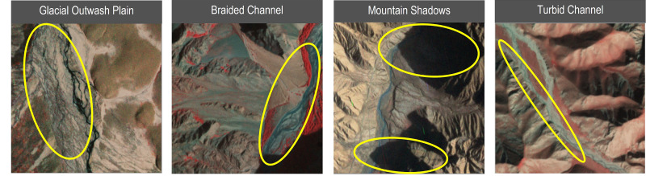
Monitoring rivers at fine scales is important for hydrological modeling
Monitoring rivers at fine spatial and temporal scales is important (e.g., for river flow)
Dynamic processes
Space-time interactions
However, it is challenging to do this
Narrow rivers, sediment-rich rivers, shadows, etc.
Image from Flores, J.A., Gleason, C.J., Brinkerhoff, C.B., Harlan, M.E., Lummus, M.M., Stearns, L.A. and Feng, D.. Mapping proglacial headwater streams in High Mountain Asia using PlanetScope imagery. Remote Sensing of Environment, 2024.
Notes:
In addition to river monitoring in general, it’s equally important to monitor rivers at fine scales, especially for hydrological modeling
The finer scales are important to track dynamic processes that have space-time interactions. A concrete example is estimating river flow.
However, it is challenging to do this because to do this, we need to handle narrow rivers, sediment-rich rivers, shadows and so on
So looking at these sample satellite images at the bottom, when these are present, it becomes harder to pinpoint exactly where the river is and do analyses. Visually, it becomes more challenging.

Slide 4
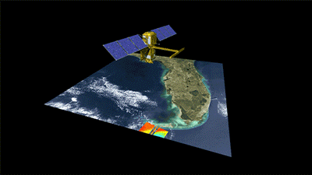
SWOT was launched to better understand surface waters
Developed by NASA and CNES, launched in 2022
With contributions from the Canadian Space Agency (CSA) and UK Space Agency
Uses radar interferometry to measure surface water heights with centimeter-level precision
However, this height critically depends on accurate river widths to measure dynamic processes like flow
While it can also estimate widths, these are of lower resolution than the heights
[3] https://swot.jpl.nasa.gov/mission/launch/
[4] https://swot.jpl.nasa.gov/resources/104/diagram-of-swot-data-collection/
Notes:
To overcome some of these issues, a satellite mission called SWOT was launched.
It was developed by NASA and CNES, launched it 2022
It uses radar interferometry
It also estimates widths, but these are of lower resolution.
And because these are lower resolution, its width estimates tend to be inaccurate
Let’s look at a concrete example on how the lower resolution can affect the accuracy

Slide 5
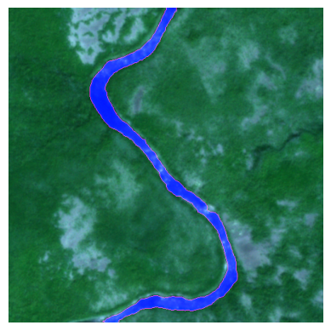
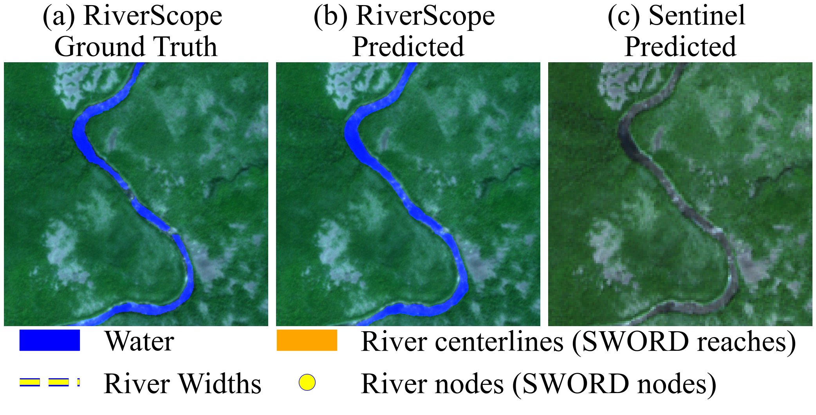
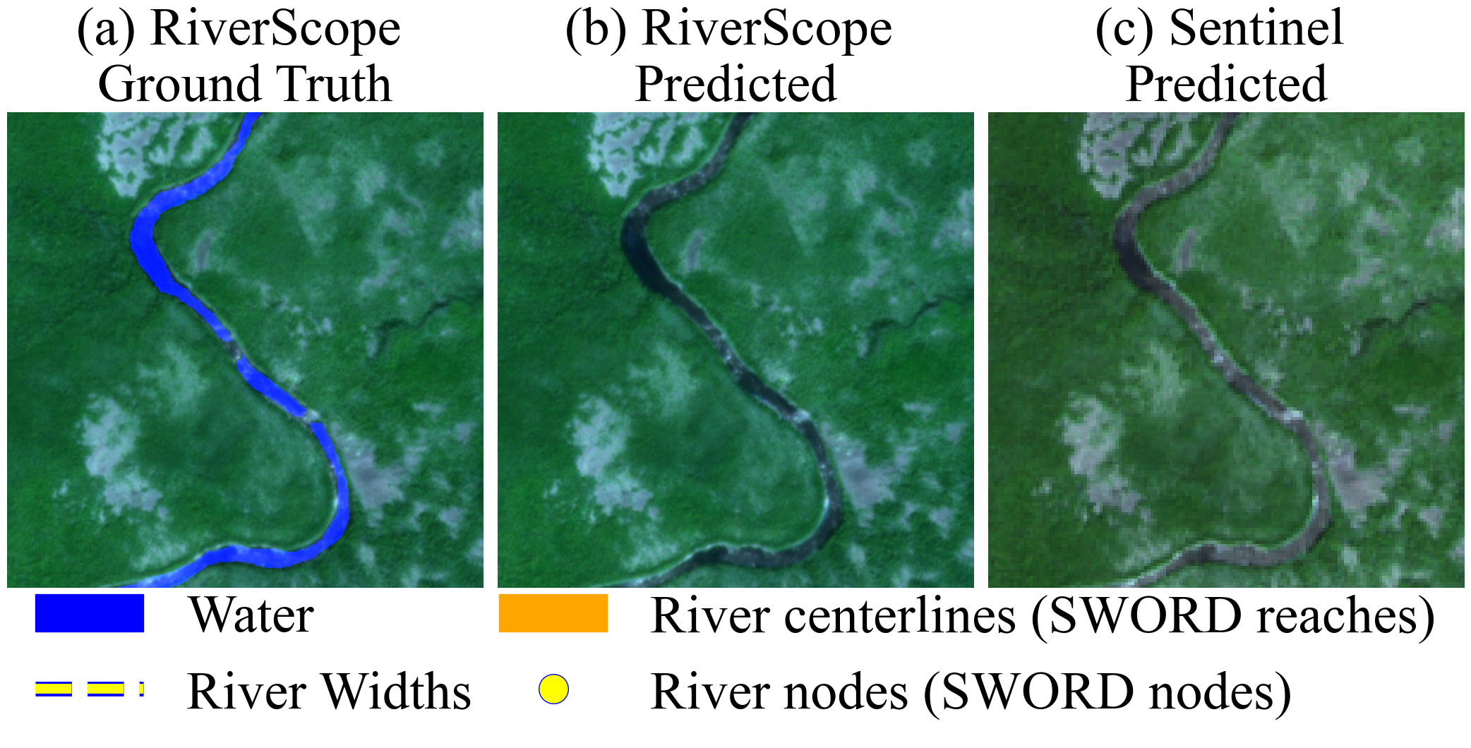
Lower resolution images can be limiting for river monitoring
~50 meter wide river
10 meters/pixel (Sentinel-2)
3 meters/pixel
1.5
km
Area=113,300 m²
Area=161,600 m²
Area=118,413 m²
Area=131,076 m²
~40,000 m² error
~10,000 m² error
Assume our method makes a 1 pixel mistake along the water boundary
If the river is 10 km long, the error can easily add up
Area=755,333 m²
Area=1,077,333 m²
Area=789,420 m²
Area=873,840 m²
~300,000 m² error
~90,000 m² error
Notes:
To illustrate, let’s look at a sample satellite image of a river at 10m/pixel resolution, the typical resolution for a Sentinel-2 imagery, which is widely used for satellite image tasks. This is a 50 meter wide river, about 1.5km long
The first step is to find where the river water is. And let’s say this is what we label manually, which corresponds to this area
Now let’s say we make a single pixel mistake along the boundary shown in red here. Now the area increases significantly, which then affects estimates like width
However, if we had a higher resolution image of 3m/pixel, and we do the same thing….
So how do we resolve this gap in performance?

Slide 6
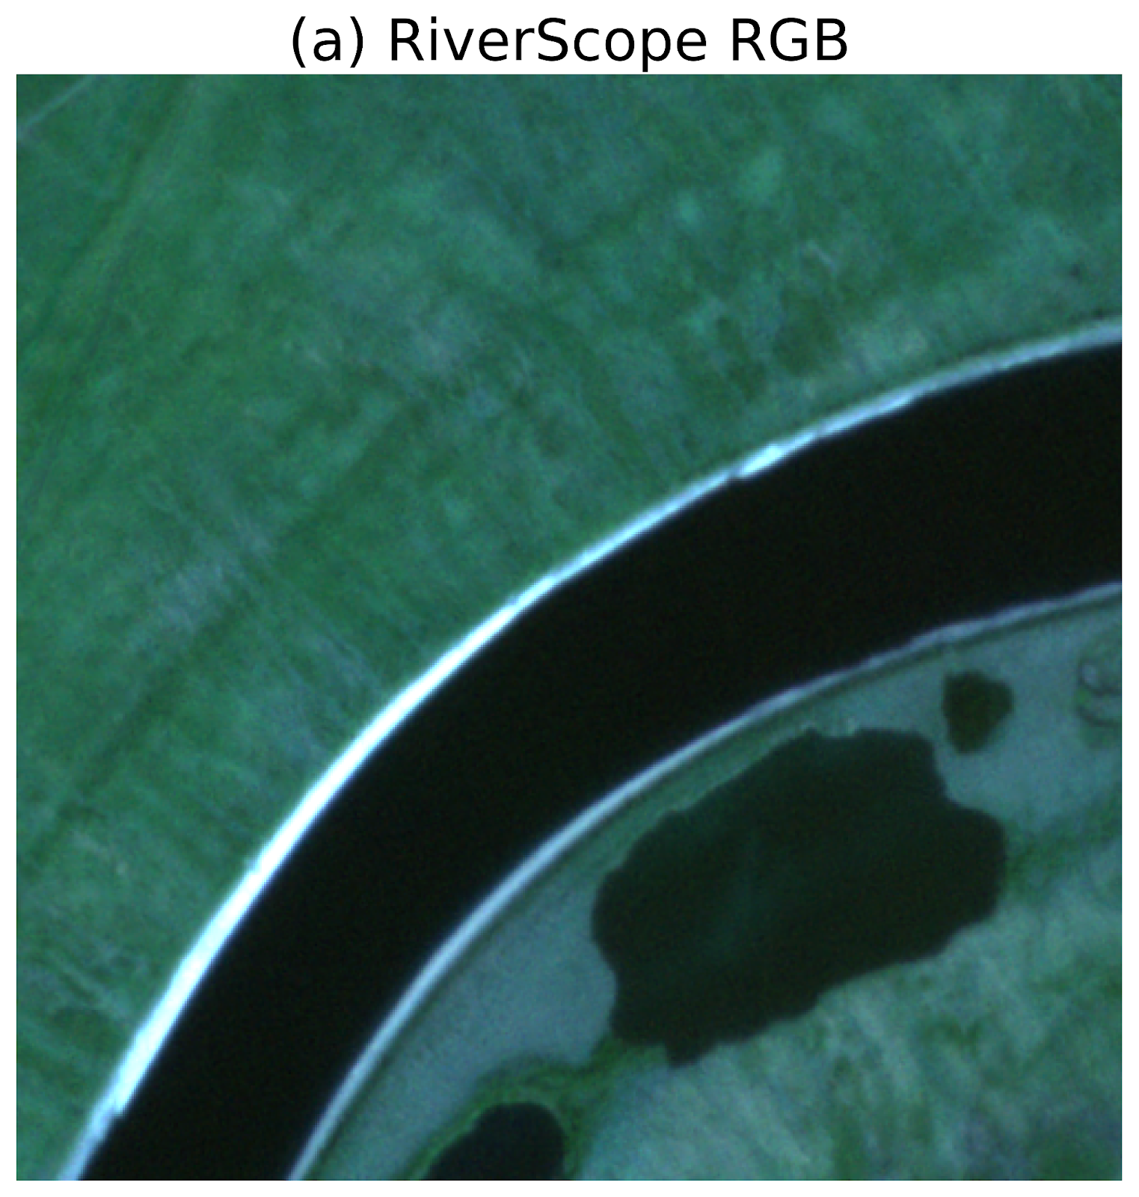
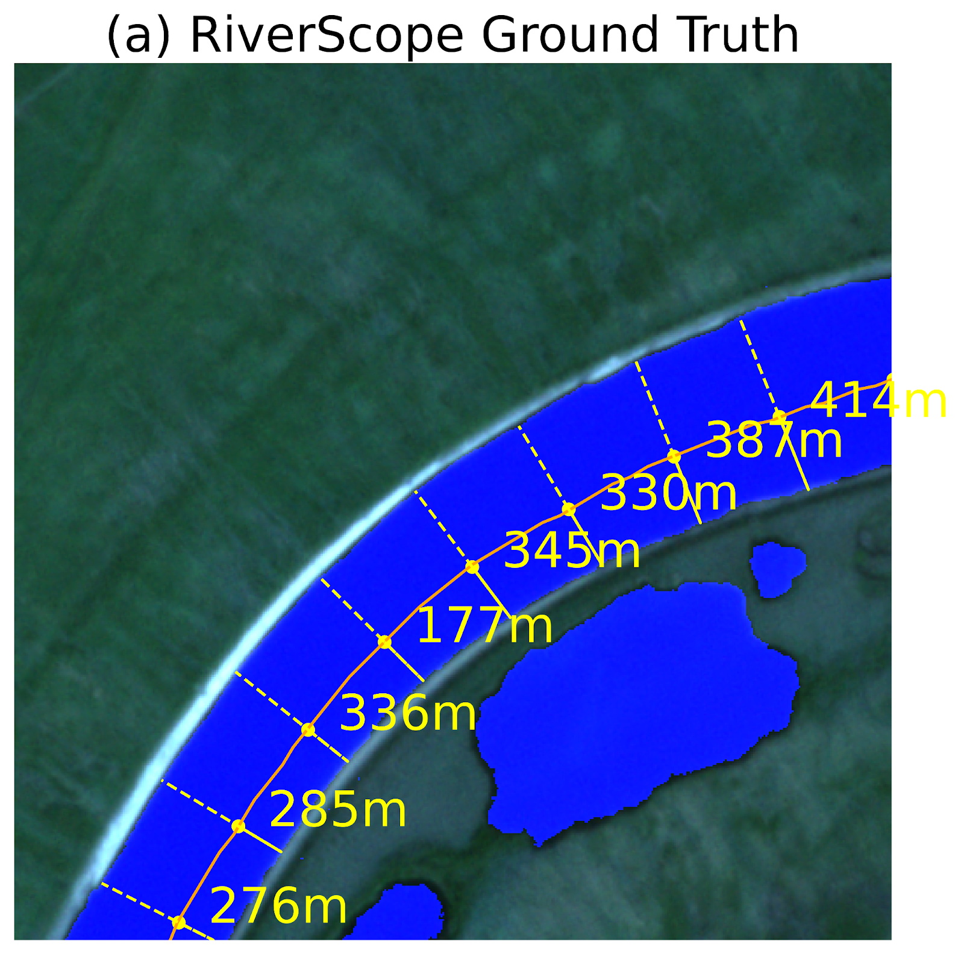
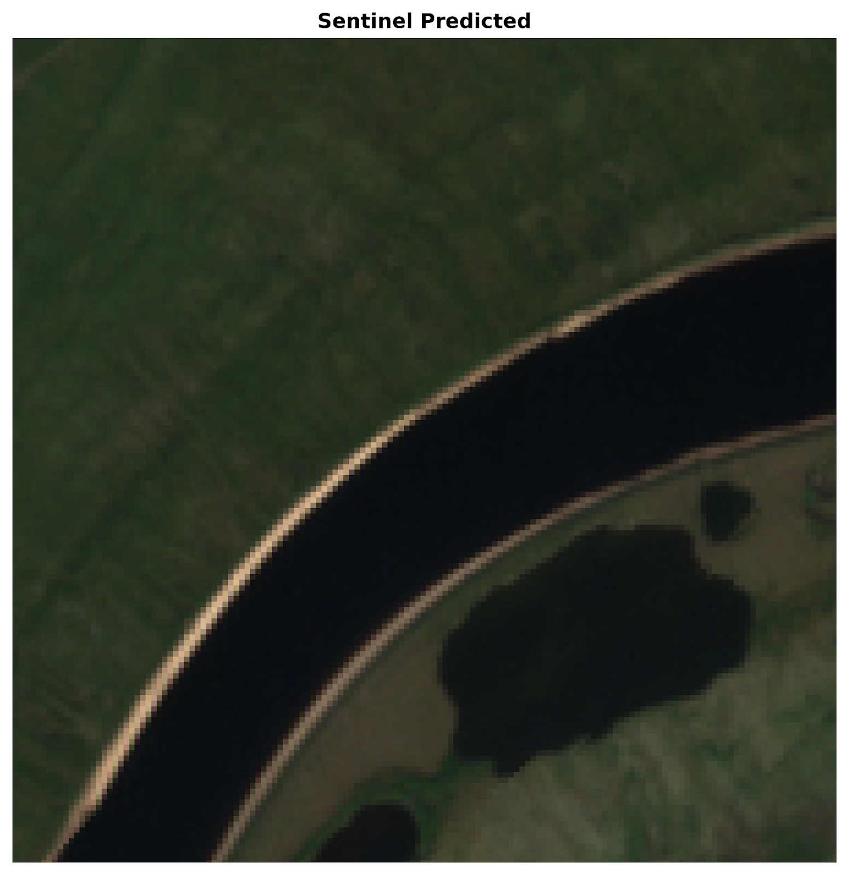
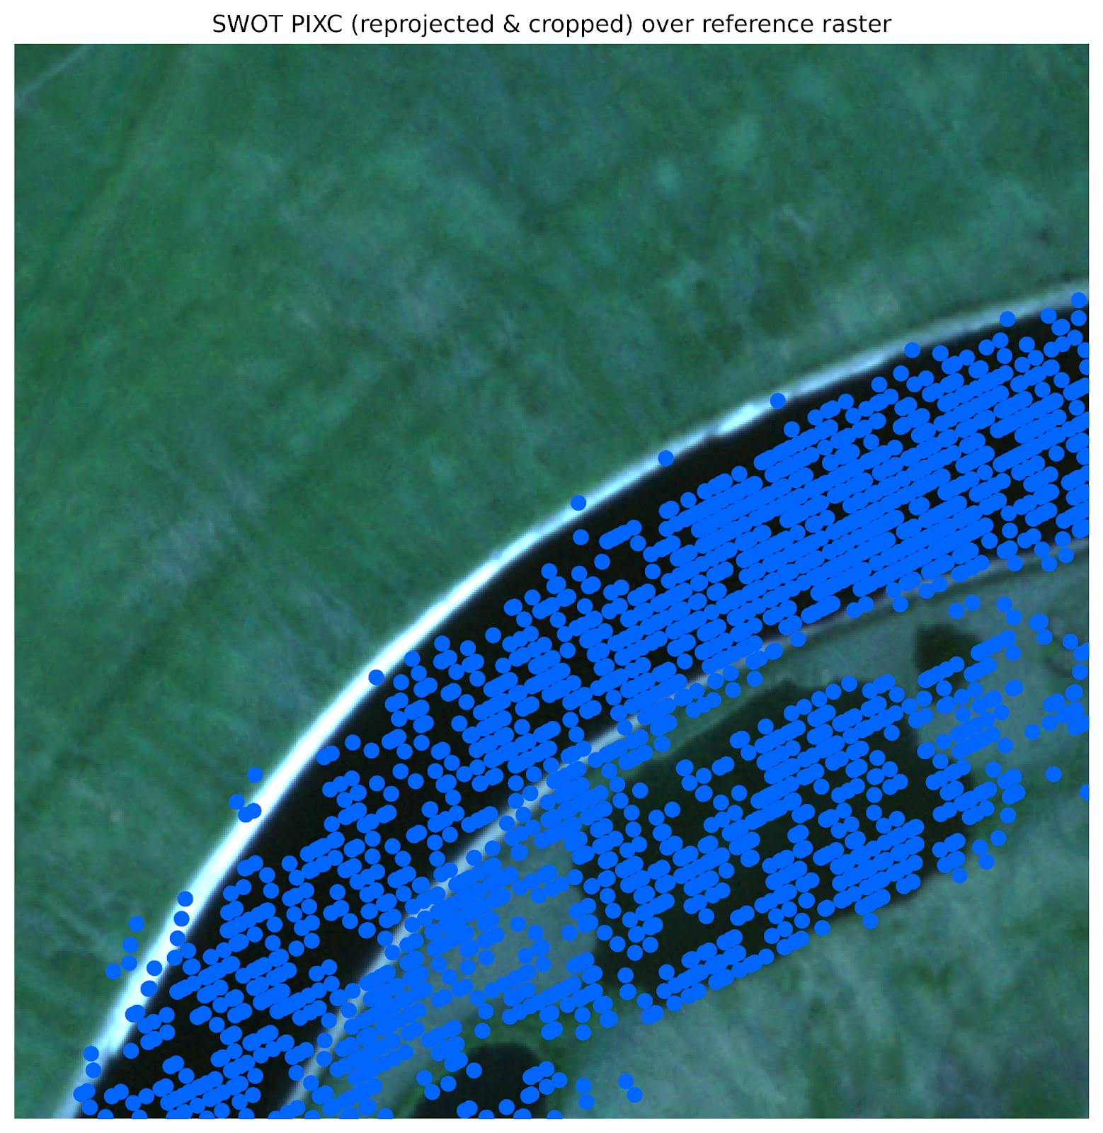
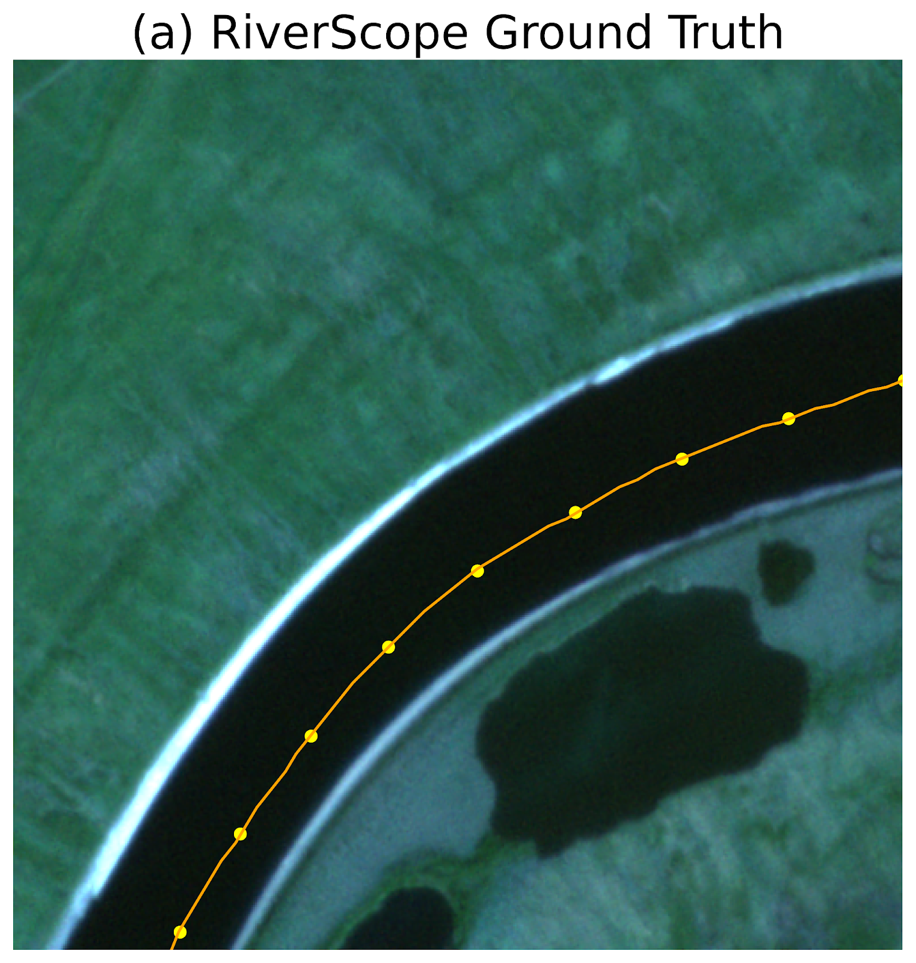
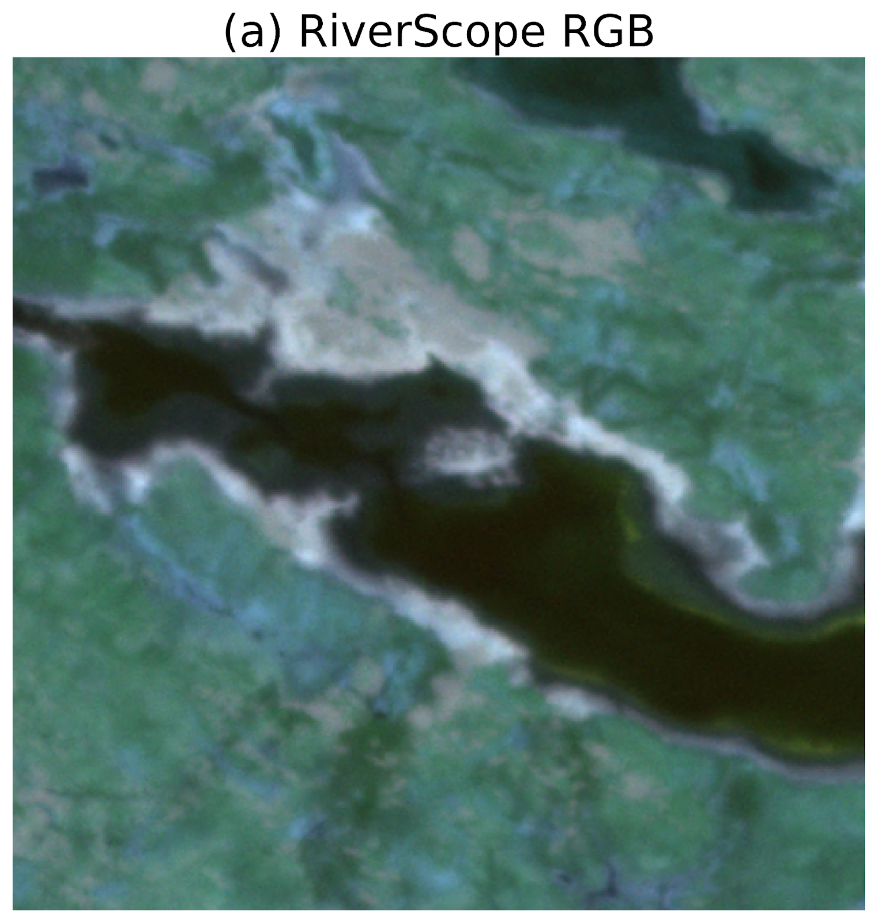
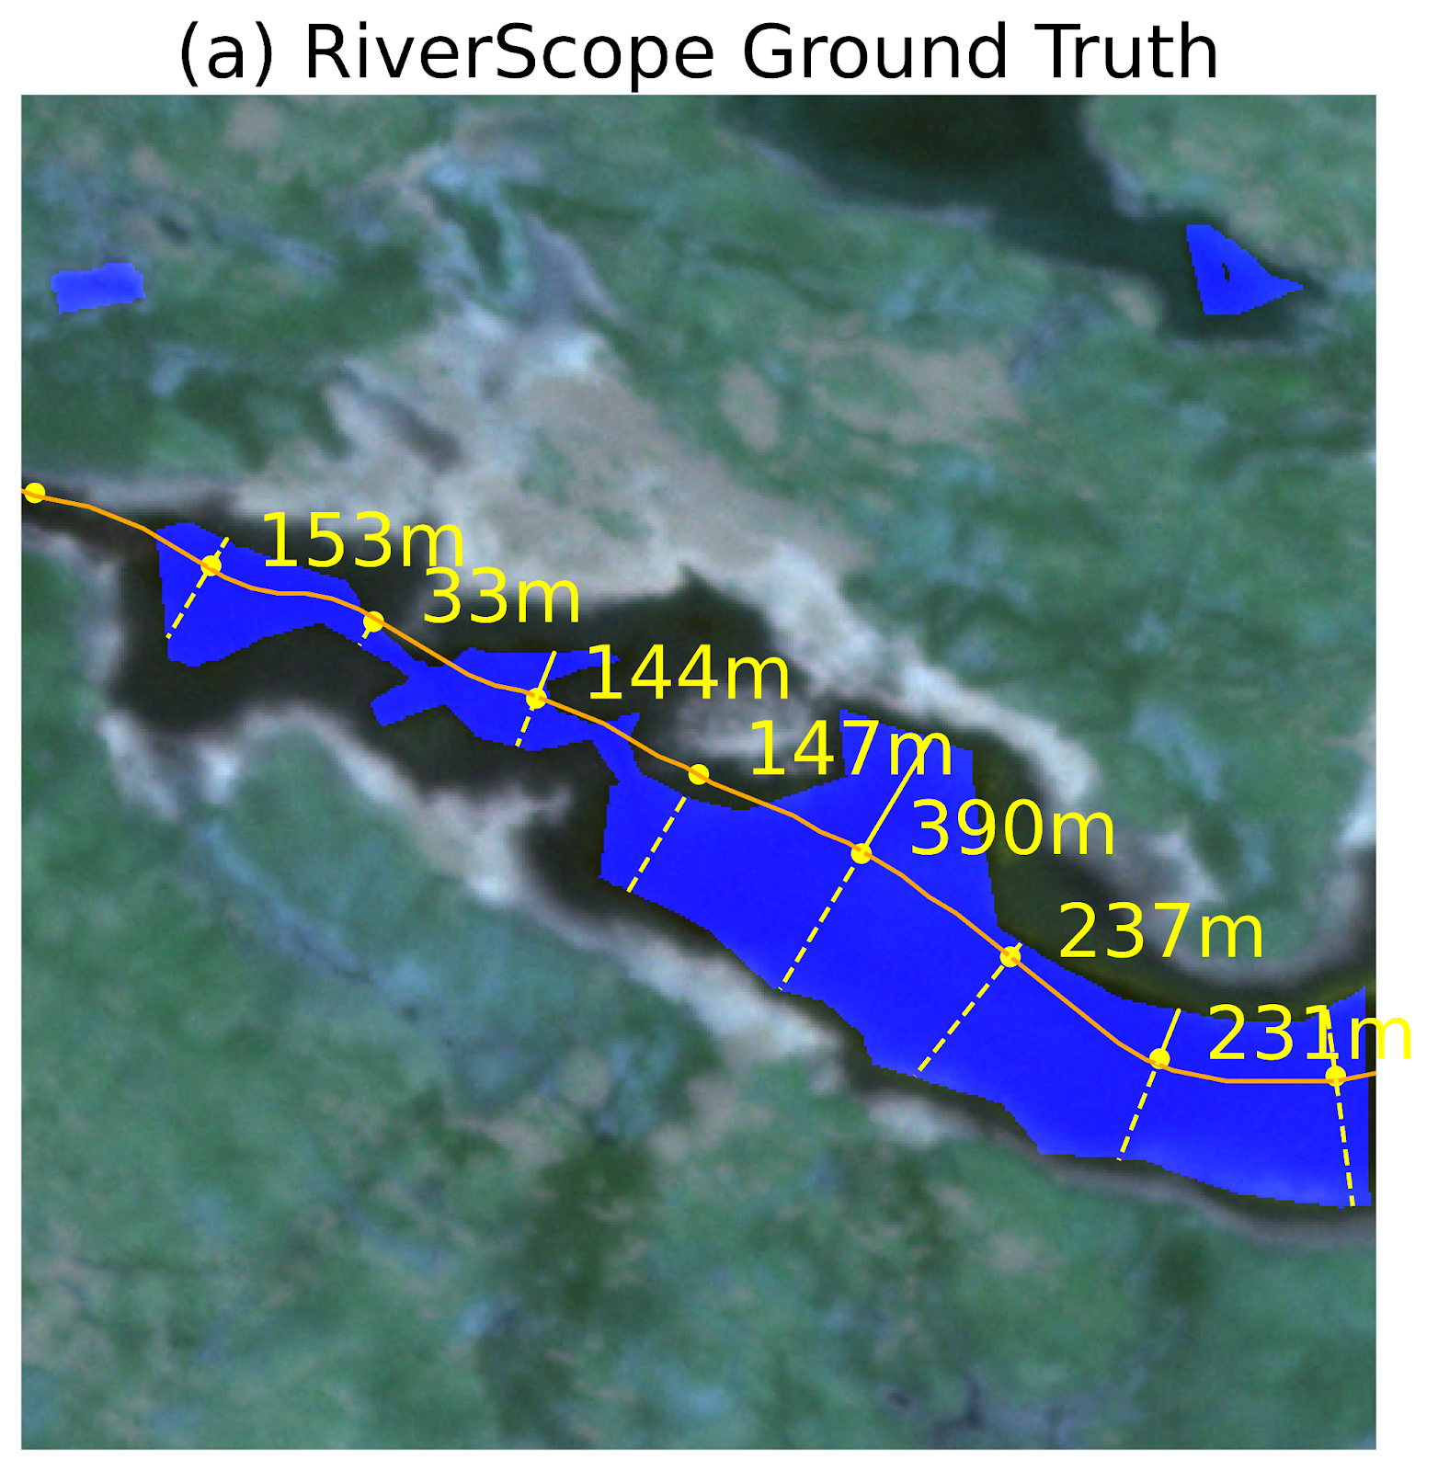
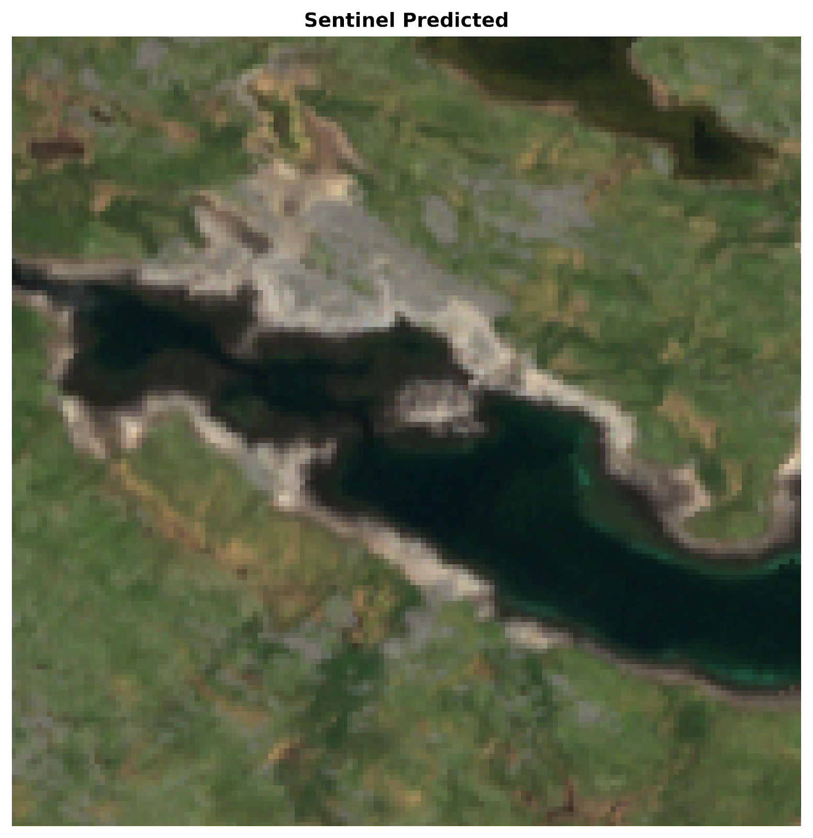
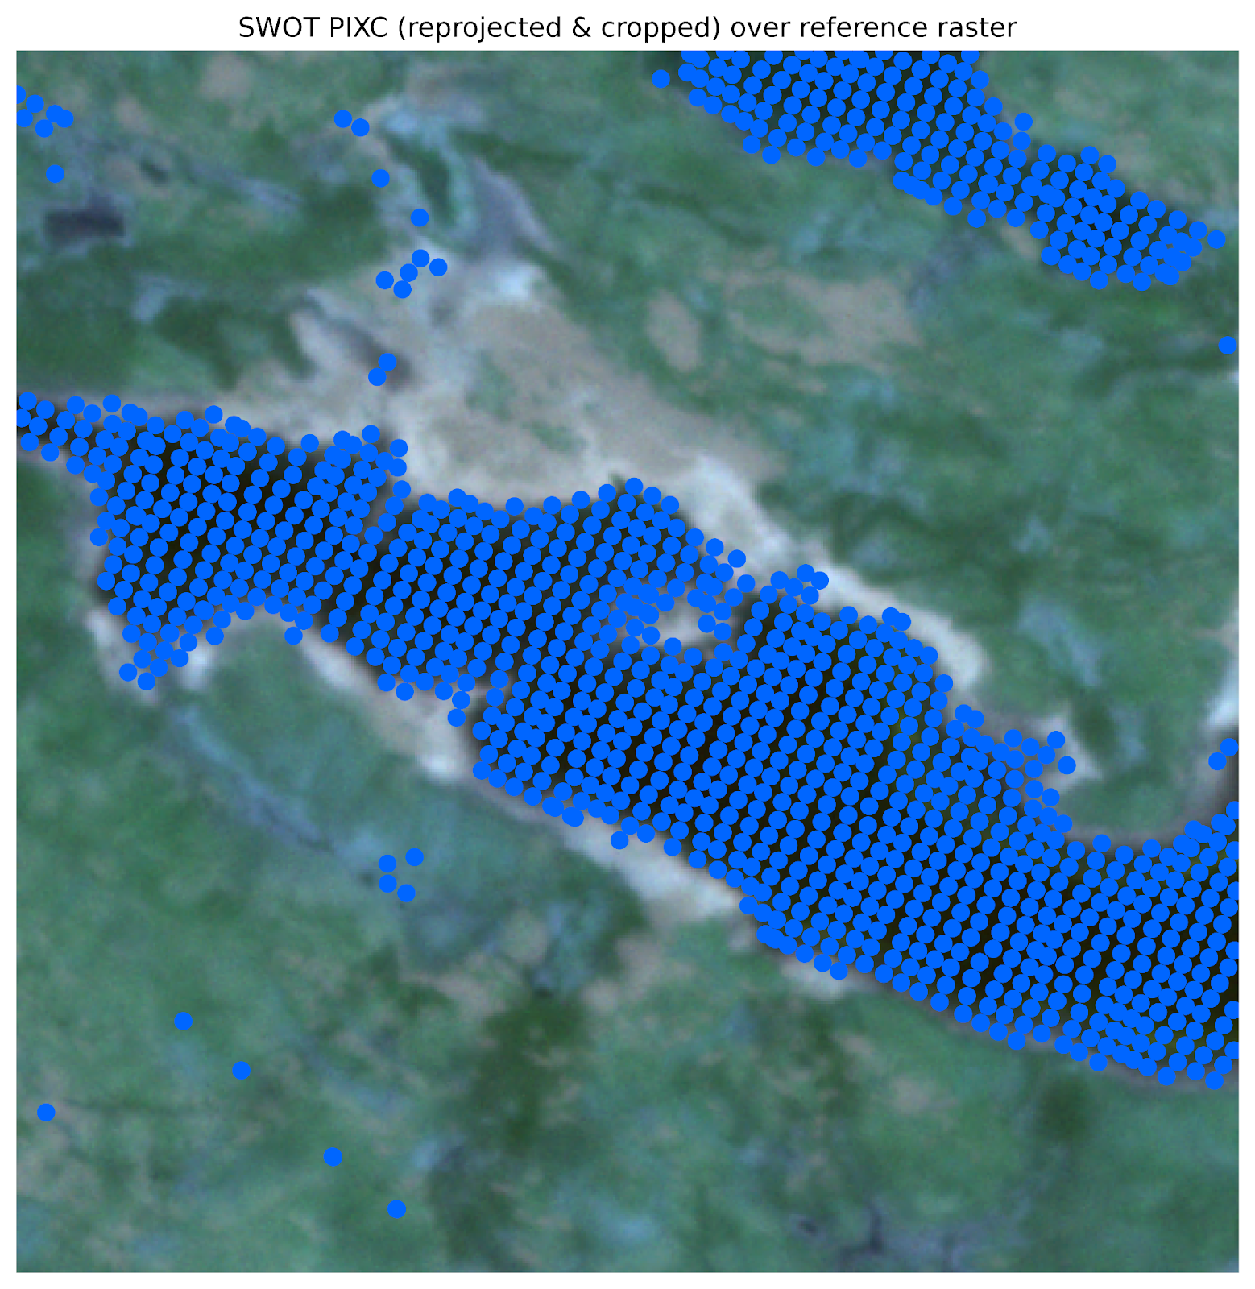
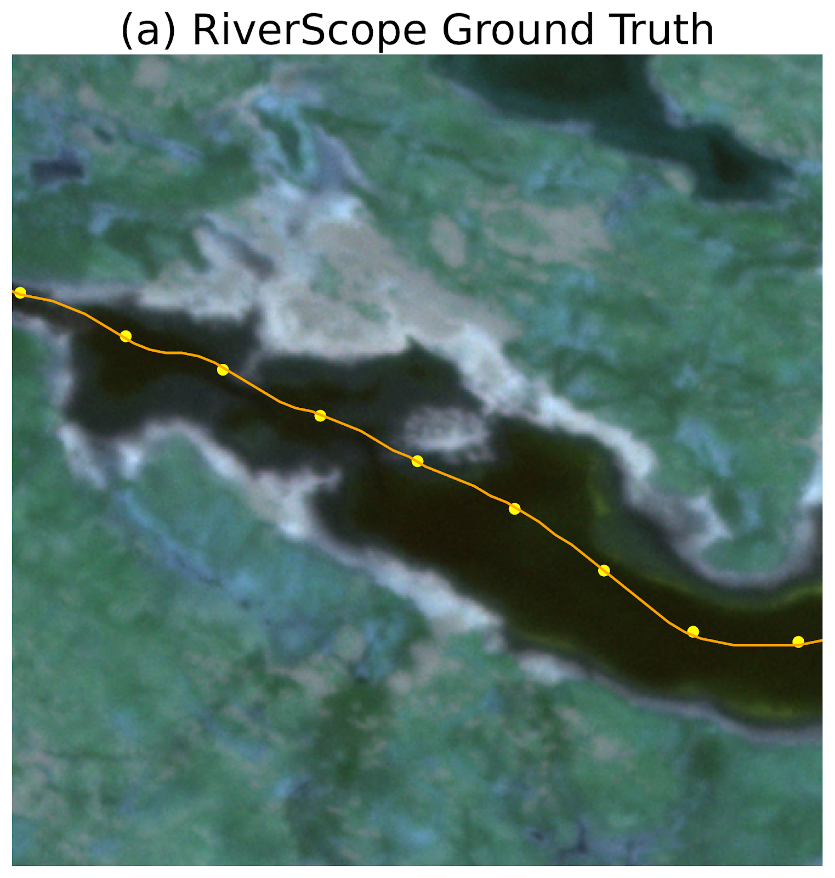
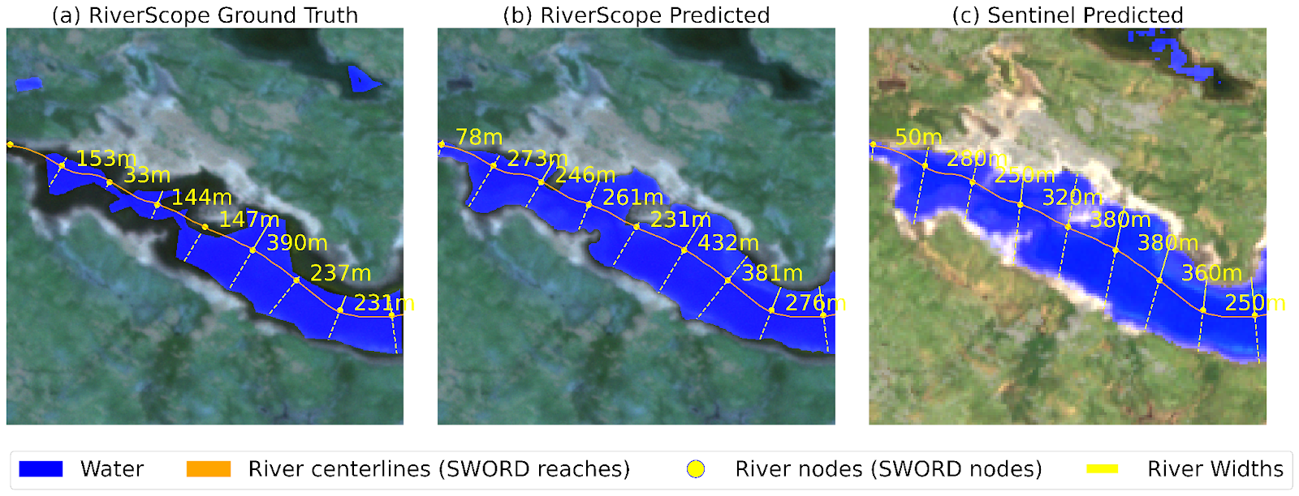
We introduce a high-resolution river masking dataset
PlanetScope
RGB Image
PlanetScope Label
Mask and Width
Sentinel-2
RGB Image
SWOT Water
Interferometry Data
SWORD River
Nodes and Reaches
RiverScope is a dataset comprised of
Satellite imagery from PlanetScope (3 m/pixel)
Expert-labeled high-resolution water masks (3 m/pixel)
Satellite imagery from Sentinel-2 (10 m/pixel)
SWOT Data
SWOT River Database
Notes:
We introduce the RiverScope dataset. Our dataset is a high-resolution river masking dataset composed of
High-resolution satellite images from PlanetScope at 3m/pixel
Accompanied by expert-labeled water masks of the same resolution. These labels were manually and carefully labeled by the hydrologists in our team, making sure water pixels were accurately identified. This is especially critical along river boundaries where pixels can be easily confused between vegetation and water pixels.
We also include data from Sentinel-2
Data from SWOT which includes precise river heights
And also the River Database that contains approximate locations of rivers with corresponding names. For example it defines lines where the Mississippi river is found historically

Slide 7
We introduce a high-resolution river masking dataset
PlanetScope
RGB Image
PlanetScope Label
Mask and Width
Sentinel-2
RGB Image
SWOT Water
Interferometry Data
SWORD River
Nodes and Reaches
RiverScope is a dataset comprised of
Satellite imagery from PlanetScope (3 m/pixel)
Expert-labeled high-resolution water masks (3 m/pixel)
Satellite imagery from Sentinel-2 (10 m/pixel)
SWOT Data
SWOT River Database
All data are co-registered in space and time for easy benchmarking and analysis
This enables evaluation of cost-accuracy trade-offs across sensors of differing capabilities
Notes:
All these data are co-registered in space and time for easy ..

Slide 8
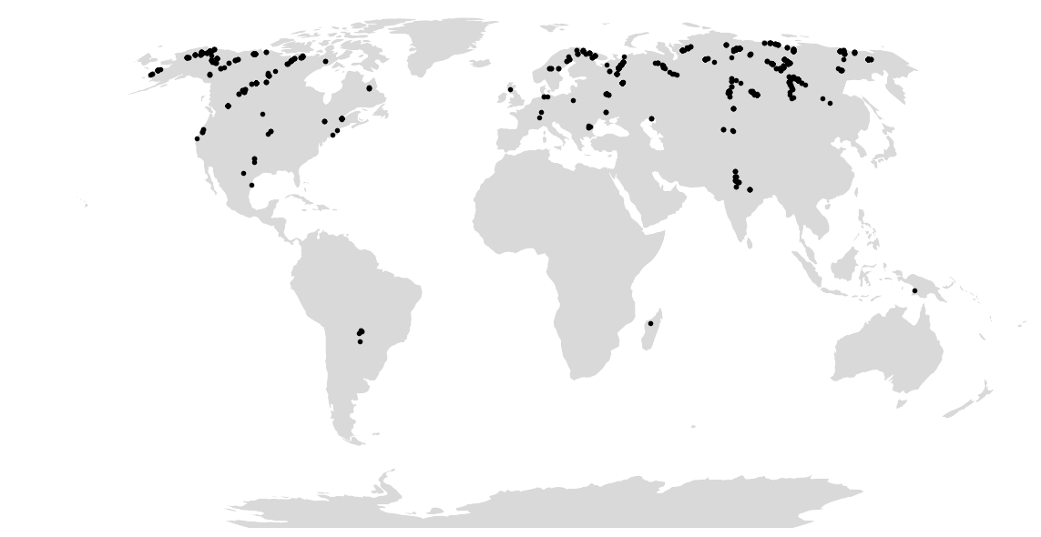
We introduce a high-resolution river masking dataset
RiverScope is a dataset comprised of
Satellite imagery from PlanetScope (3 m/pixel)
Expert-labeled high-resolution water masks (3 m/pixel)
Satellite imagery from Sentinel-2 (10 m/pixel)
SWOT Data
SWOT River Database
 | Images (#) | Reaches (#) | Area (km²) | Water (%)
Train | 787 | 164 | 1,771 | 23.04
Val | 123 | 23 | 277 | 29.95
Test | 235 | 48 | 529 | 21.49
Total | 1,145 | 235 | 2,577 | 23.45
We take data along SWOT’s fast sampling orbit to maximize overlap with available SWOT data, while sampling for varying river widths
Notes:
This is the distribution of our dataset
We note that it is a high latitude dataset, because we take data along SWOT’s fast sampling orbit to maximize overlap with available SWOT data
We also sample for varying river widths ranging from about 50 meters to more than 1 kilometer wide

Slide 9
Can RiverScope help with river monitoring tasks?
We train models using the RiverScope dataset
Input: high-resolution PlanetScope imagery
Label: manually labeled water masks
We focus on two tasks
River segmentation
River width estimation
PlanetScope imagery
River segmentation
River width estimation
We compare performance against
Previous PlanetScope-based models
NDWI
Custom CNN without pre-training(Valman et al., 2024) [5]
Sentinel-2-based models
Computer Vision Model
Segmentation Models: UNet, FPN, DPT, DeepLabv3
Encoders: CNNs (RN50, MV2, etc), Transformers (ViT, Swin, etc)
Pre-training: ImageNet, CLIP, Prithvi, SatlasNet, etc
[5] S. J. Valman, D. S. Boyd, P. E. Carbonneau, M.F. Johnson, S.J. Dugdale. An AI approach to operationalize global daily PlanetScope satellite imagery for river water masking. Remote Sensing of Environment, 2024.
Notes:
Ok great, so we have this dataset. The next question is: does it actually help with river monitoring tasks?
We look into two tasks for river monitoring: river segmentation and width estimation
So how that looks is we take the high resolution imagery as input to our model, which outputs the river segmentation. From there, we derive the river width estimates
To illustrate the benefit of our RiverScope dataset, we experiment with different segmentation models, encoders, and pre-training methods
Encoders range from CNNs to transformers
While pre-training looks into both satellite-based pre-training like Prithvi and Satlas, and also non-satellite pre-training like ImageNet and CLIP
We then compare the performance against (1) previous models that use high-resolution planetscope imagery as well. One of which is widely used in the hydrology community called NDWI, which is a threshold based method for finding rivers. We also compared against a custom CNN model that uses PlanetScope data for training
(2) We also compare against the same models trained on lower resolution Sentinel-2 data to see the effect of the higher resolution data on our river monitoring tasks

Slide 10
Training with RiverScope results in better river segmentation
Models trained with Sentinel-2 data do not perform as well as simple high-resolution models
Training models with RiverScope data leads to best performance across different settings
Notes:
First let’s look at the performance for river segmentation. The y-axis is F1 Score, where higher is better.
- This is what you get when you threshold with NDWI
- This is what you get when you use a baseline custom CNN trained on PlanetScope
We always want to be above dotted line, and we always are

Slide 11
Training with RiverScope results in better river width estimates
Models trained with Sentinel-2 data have higher width estimation errors
Training models with RiverScope data leads to best performance
* GRWL uses Landsat-derived widths (30 meters/pixel)
Notes:
Now we look at results for river width estimation. The y-axis here is the median absolute error, so lower is better.
We always want to be below dotted line, and we always are

Slide 12
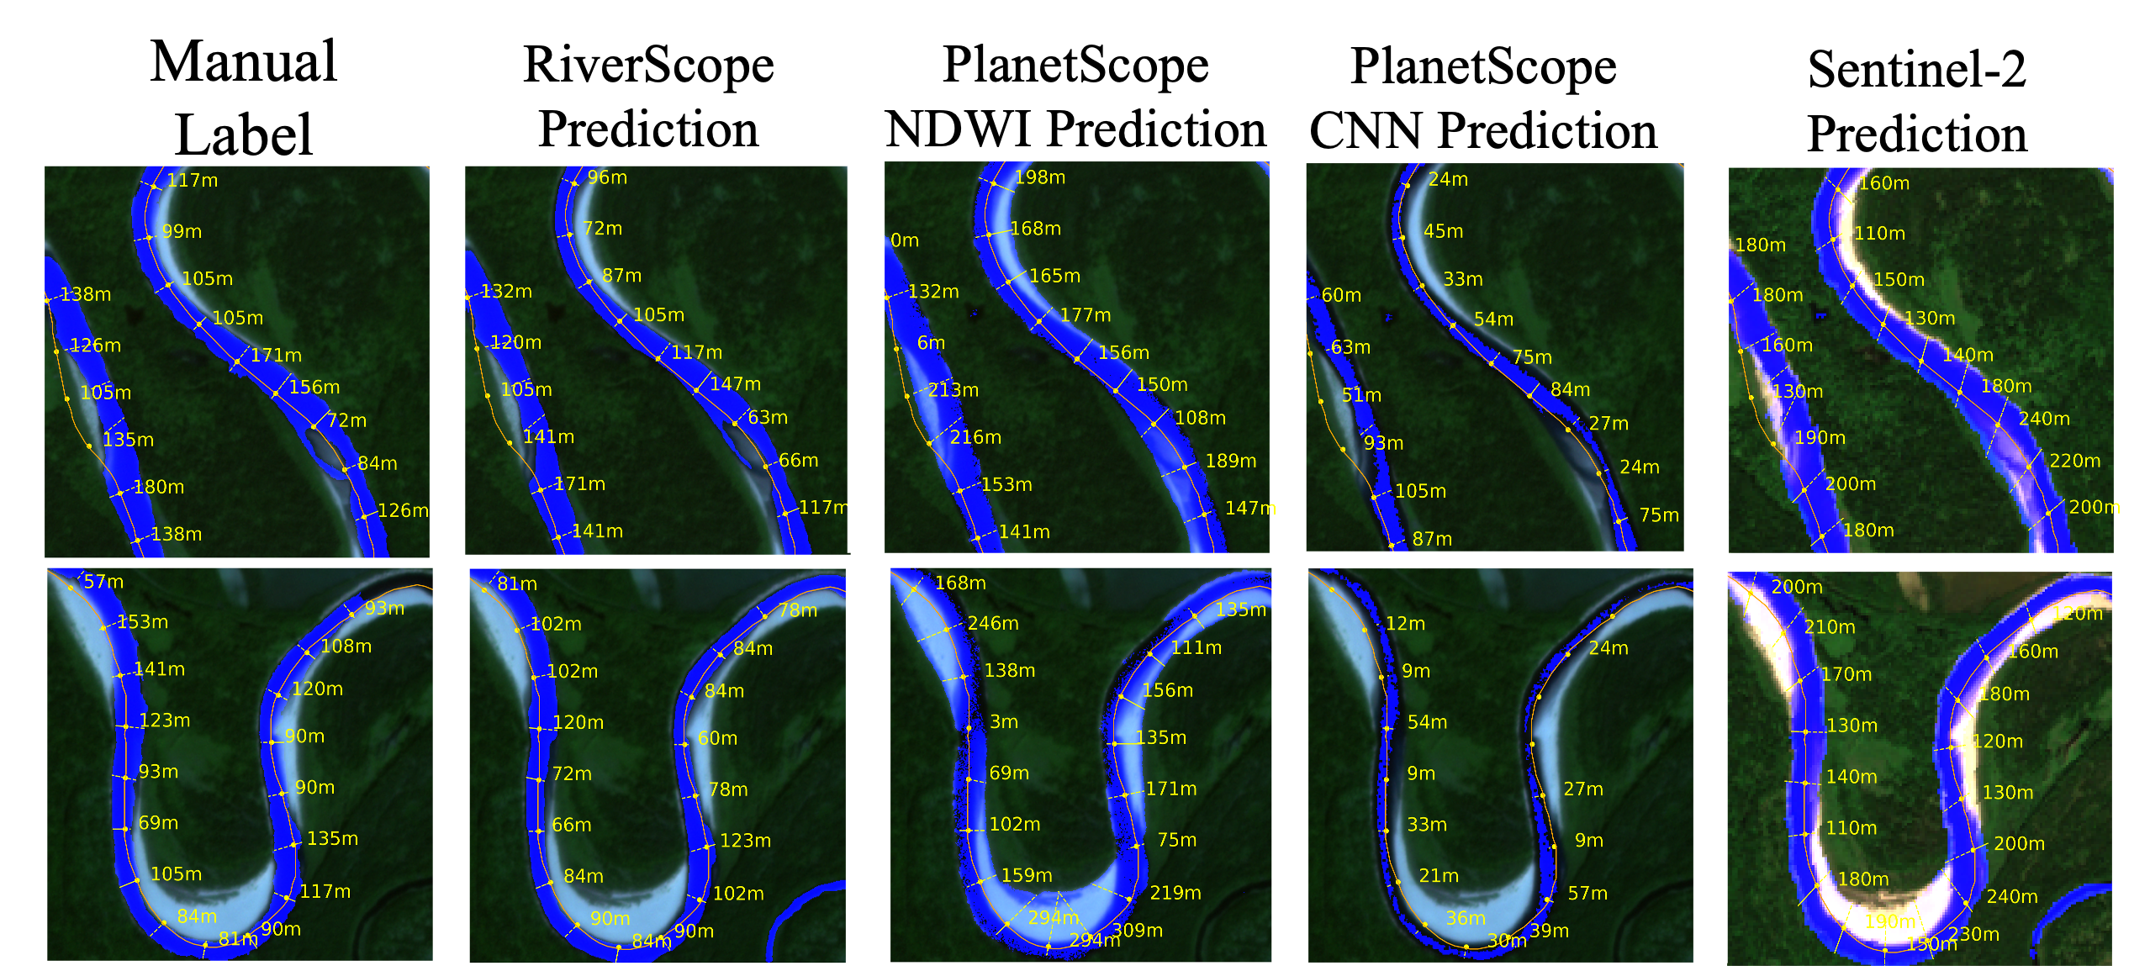
Conclusion and Future Work
Using our high-resolution RiverScope data for training models results in a significant boost in performance for river monitoring tasks compared to baseline methods
We can use models trained on RiverScope to create high-resolution water masks for precise river monitoring at a larger scale
Due to the presence of multiple sensors, our dataset can enable future work on other applications to explore cost-accuracy tradeoffs
Notes:
For example, SWOT uses radar interferometry so it can be less sensitive to clouds when compared to optical data from PlanetScope or Sentinel2, but its lower resolution when estimating wdiths can affect performance. So these considerations
So we’re excited to see this dataset being used and allow us to gain more insights about rivers at a global scale

Slide 13
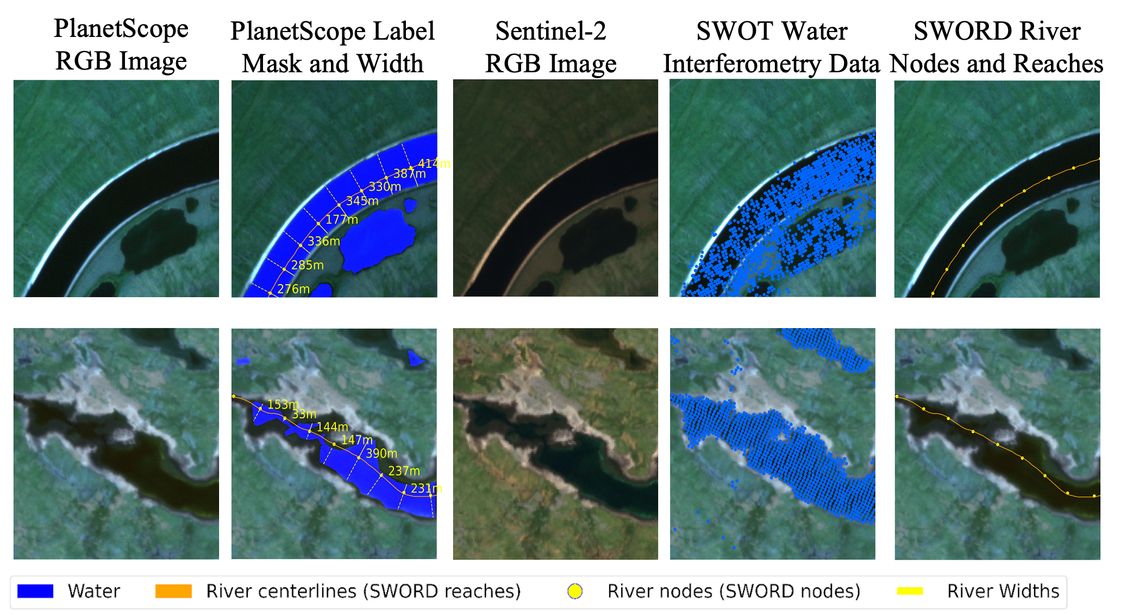
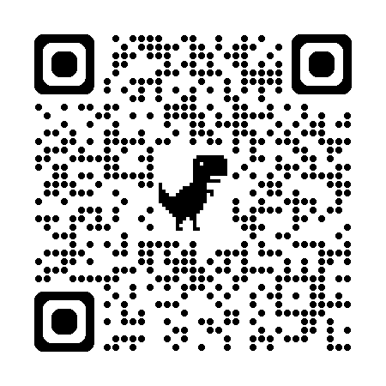
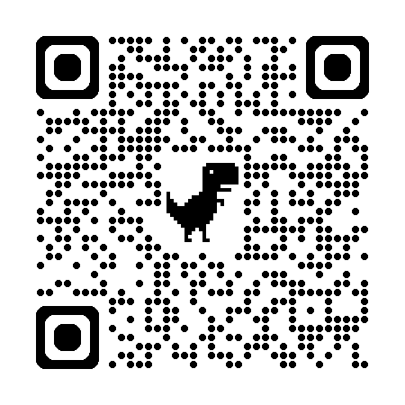
Thank you!
RiverScope: High-Resolution River Masking Dataset
We introduce a dataset with expert-labeled river masks
All images are co-registered with SWOT, SWORD, and Sentinel-2, enabling the evaluation of cost-accuracy trade-offs across sensors of differing capabilities
Using the dataset for training improves river segmentation and river width estimation over baselines and lower resolution alternatives
arxiv.org/abs/2509.02451
github.com/cvl-umass/riverscope
Email: rdaroya@umass.edu
Rangel Daroya, Taylor Rowley, Jonathan Flores, Elisa Friedmann, Fiona Bennitt, Heejin An, Travis Simmons, Marissa Jean Hughes, Camryn L Kluetmeier, Solomon Kica, J Daniel Vélez, Sarah E Esenther, Thomas E Howard, Yanqi Ye, Audrey Turcotte, Colin Gleason, Subhransu Maji. RiverScope: High-Resolution River Masking Dataset. Association for the Advancement of Artificial Intelligence (AAAI), 2026.

Slide 14
Where do errors occur?
True Positive
False Positive
False Negative
True Negative
Using WorldCover [6] data, we analyze possible sources of error for detecting rivers
RiverScope’s finer resolution results in less false positives along the river boundary
More precise river segmentations and width estimates
[6] Van De Kerchove, R.; Zanaga, D.; Keersmaecker, W.; Souverijns, N.; Wevers, J.; Brockmann, C.; Grosu, A.; Paccini, A.; Cartus, O.; Santoro, M.; et al.. ESA WorldCover: Global land cover mapping at 10 m resolution for 2020 based on Sentinel-1 and 2 data. In AGU Fall Meeting Abstracts, 2021.

Slide 15
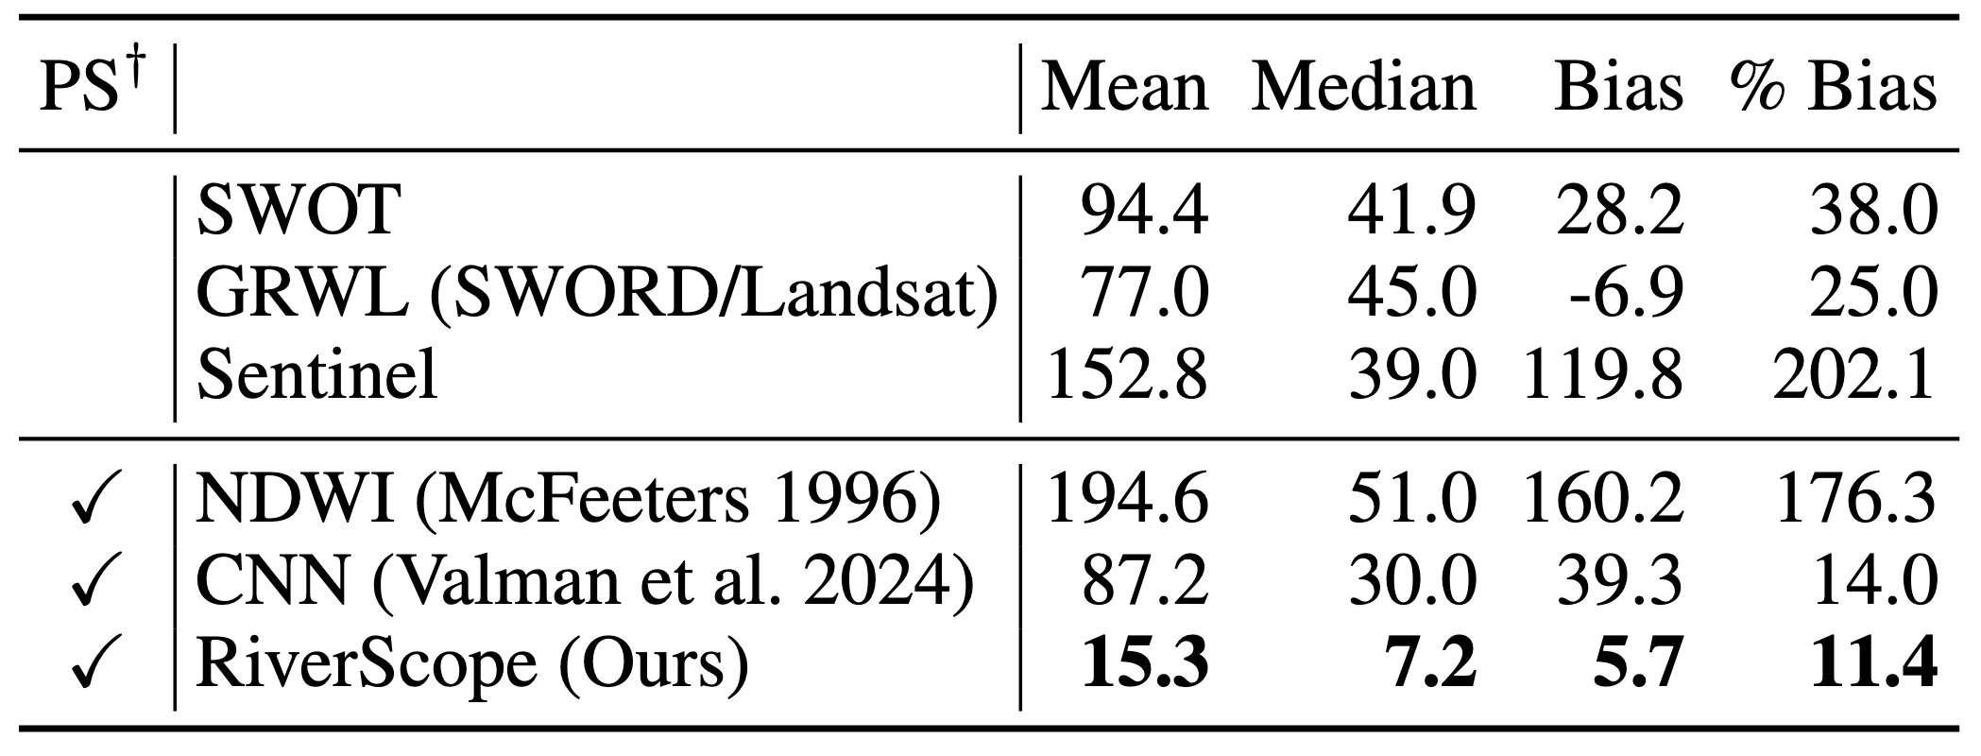
Training with RiverScope results in better river width estimates
Deep learning models trained with Sentinel-2 data have higher width estimation errors
Training deep learning models with RiverScope data leads to best performance

